Slide 1
Tables dependencies resolution
You can tell dbt which tables you want to build and it will automatically build all the other tables on which this table is dependent in a correct order and it will make sure that none table is built twice.
We can run a single command saying ‘build all tables’ and dbt will build all the tables in a correct order, without building any table twice.
For example let’s say that table2 and table3 are both dependent on table1. dbt helps us avoiding problems such as:
We build table2 while table1 has not been built yet.
We build table1 and table2, and after that we build table1 and table3. The table1 has been built twice.
Problem2: We build table1 twice, in two processes. One process is building table2, second one is building table3.
Correct order of building:
Problem1: We build table2 without building table1
table1
table1
table1
table2
table2
table3
table2
table3
Process 1
Process 2

Slide 2
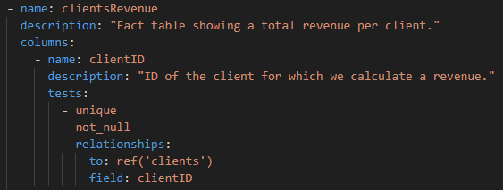
Data quality tests
In dbt we are creating YAML files in which we can specify data quality tests. For example on the below example we are checking if ClientID satisfies the following checks:
Values are unique
There are no null values
Every value have corresponding value in the ‘clients’ table (as it is a foreign key).

Slide 3
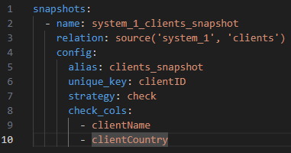
Slowly changing dimensions type 2
We can use snapshots in order to create slowly changing dimensions type 2. We are defining snapshots in a YAML file.
For example, in the below snapshot we are creating snapshot in such a way that we will create a new record everytime values in the specified columns changes.
If the clients table have the following columns:
clientID | clientName | clientCountry
The output snapshot will have the following columns:
scd_id | clientID | clientName | clientCountry | valid_from | valid_to

Slide 4
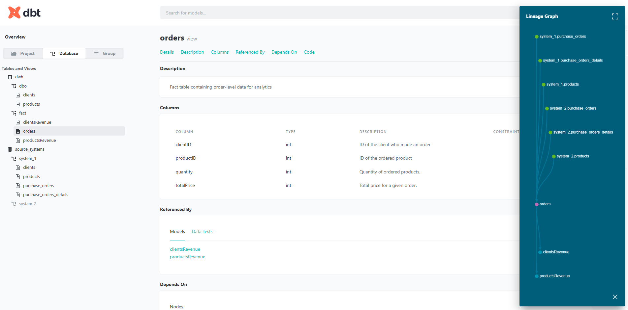
Data documentation
dbt generates a website with data documentation like it is shown below. Tables and columns descriptions are defined in YAML files like it is shown in the previous slide.

Slide 5
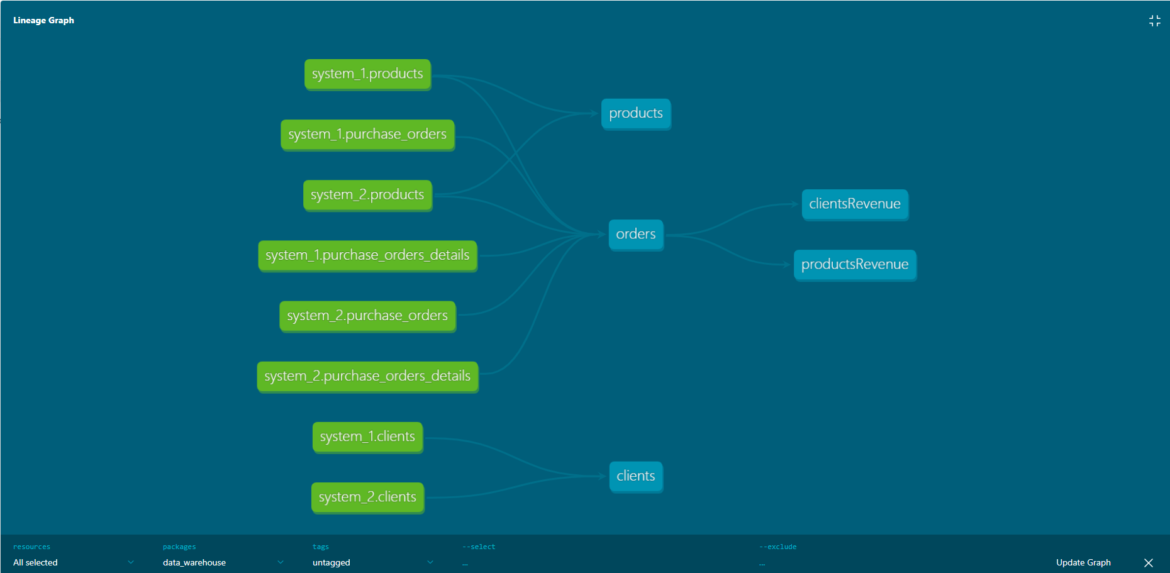
Data documentation
dbt generates a website with data documentation like it is shown below.

Slide 6
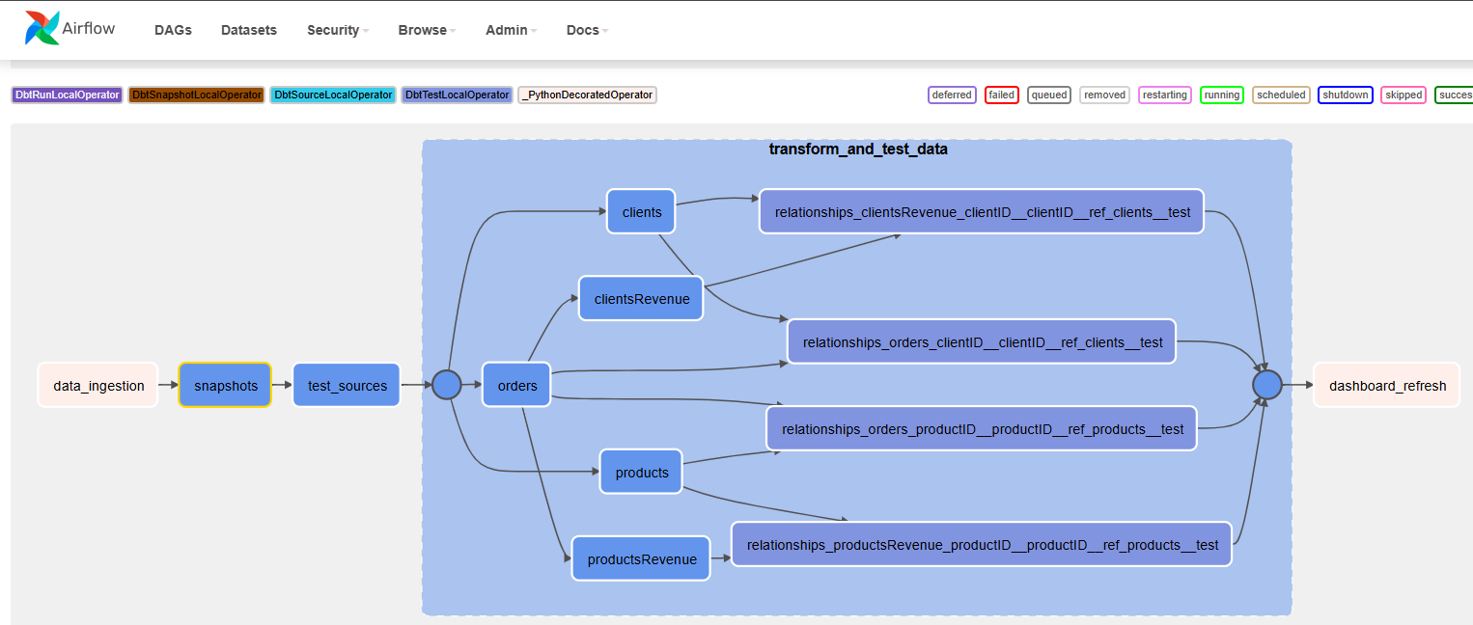
Data documentation
If we run dbt in Airflow using cosmos then we will also see data lineage in an Airflow graph. If we click on a specific task we can see the code used for building a table and logs. In that Airflow graph we can have also other tasks than dbt transformations.

Slide 7
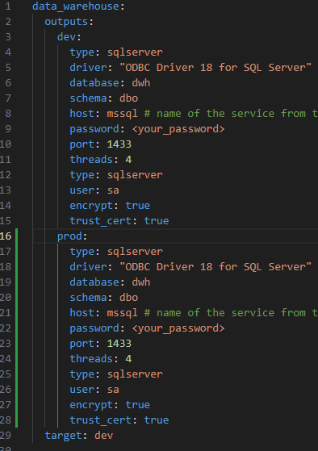
Specifying the target database
In dbt we can easily define a location in a database our models will be built. We can specify different targets in the profiles.yml file.
Here we have for example two targets, ‘dev’ and ‘prod’. For each of them we are specifying database parameters where they will be saving data.

Slide 8
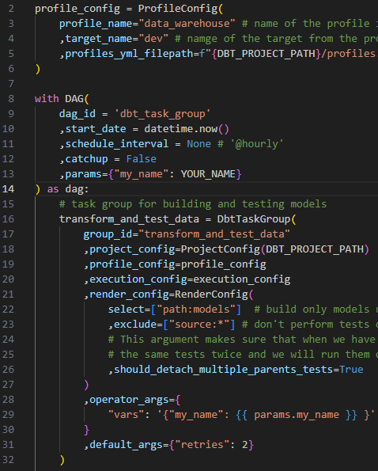
Specifying the target database
Then in a Python script creating Airflow DAG we can specify which target we want to use:
And which tables we want to build in that target:

Slide 9
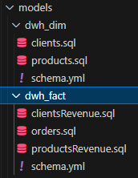
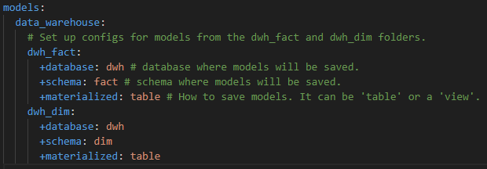
dbt_project.yml
In the dbt_project.yml file we are specifying our dbt project configuration.
For example we might create models in different folders and in the dbt_project.yml we are specifying where those models will be saved in the database (in which database and schema) and how they will be materialized (we can create a view or a table).
dbt models structure in a project
dbt_project.yml

Slide 10
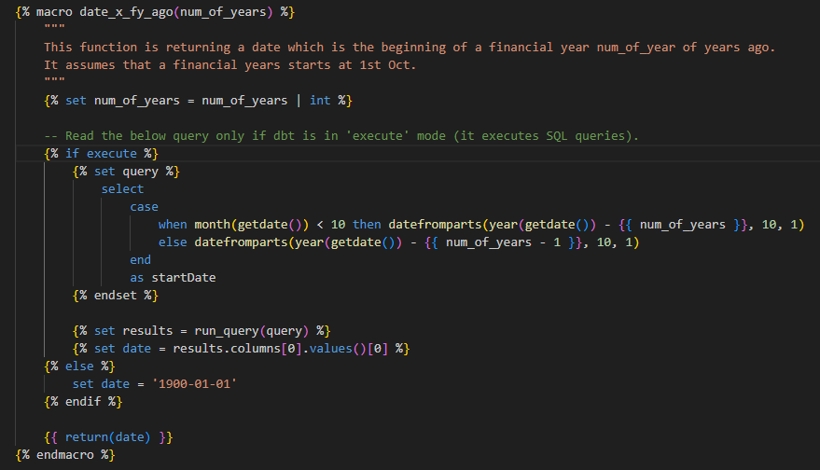
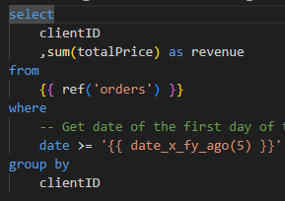
Macros
Macros are functions which we can use in our SQL queries. For example below we have a macro which is returning a data which is a beginning of a financial year specified number of years ago. It assumes that financial year begins at October. Below is also a query which is using this macro. In dbt we can use Jinja except for SQL which gives us more flexibility.
Macro definition
Macro usage

